Slide 1
Agenda for Module 2: Algorithms
Part 1:
Data Structures
Part 2:
Search Algorithms
Time Complexity
Sorting Algorithms
Part 3:
Graph Algorithms
Overview of Algorithmic Techniques

Slide 2
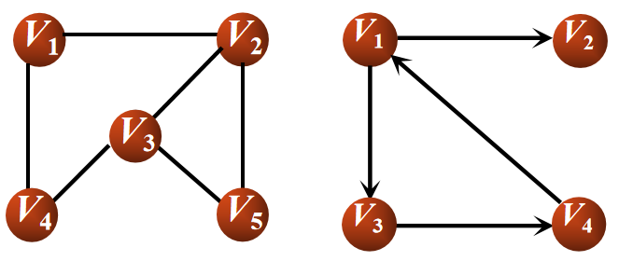
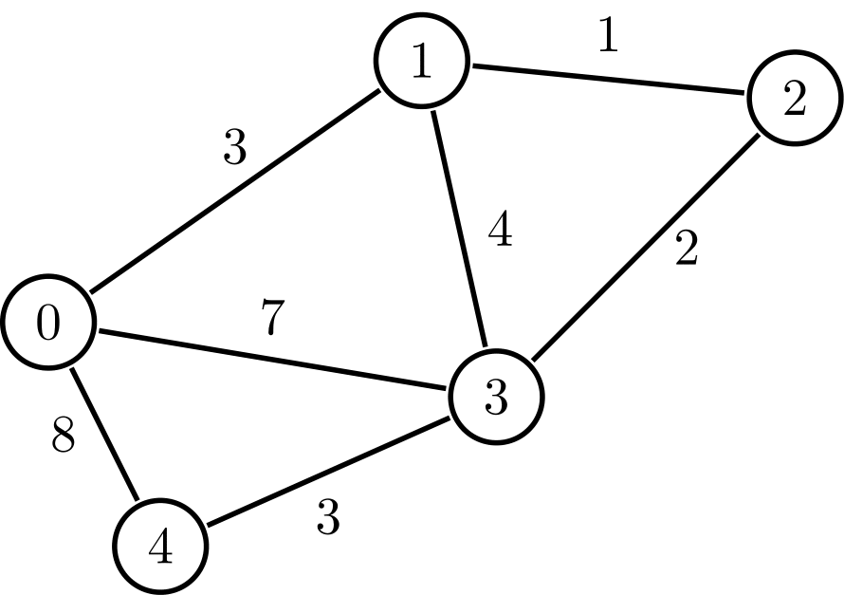
Graph Basics
Set of :
Nodes/ Vertices contains values and links to its neighbors
edges connecting the nodes
Edges can be
Undirected: no distinction between the 2 nodes
Directed: has a source and a destination
Weighted
Node
Edge
Undirected Graph
Directed Graph
Weighted Graph
Directed Graph

Slide 3
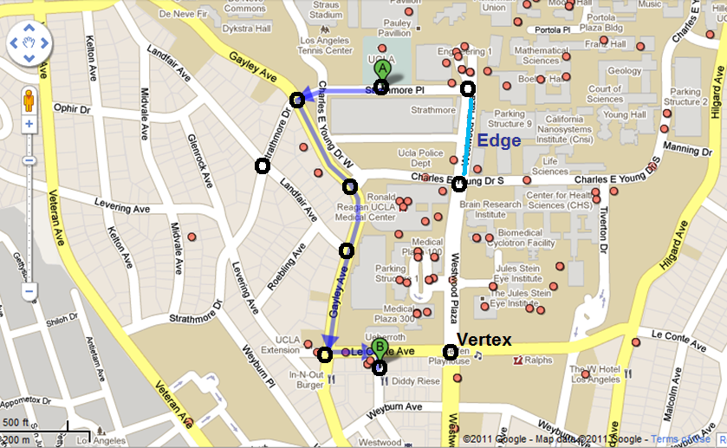
Applications - Navigation
Google Maps - determining the fastest route

Slide 4
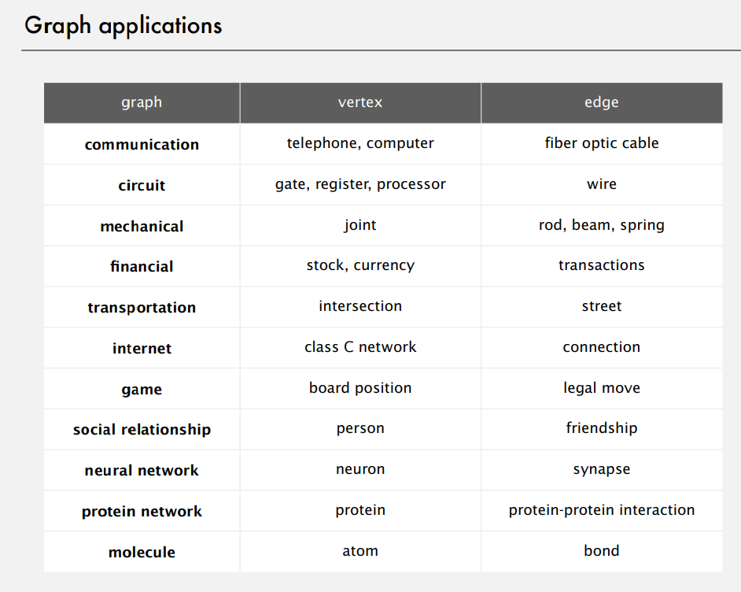

Slide 5
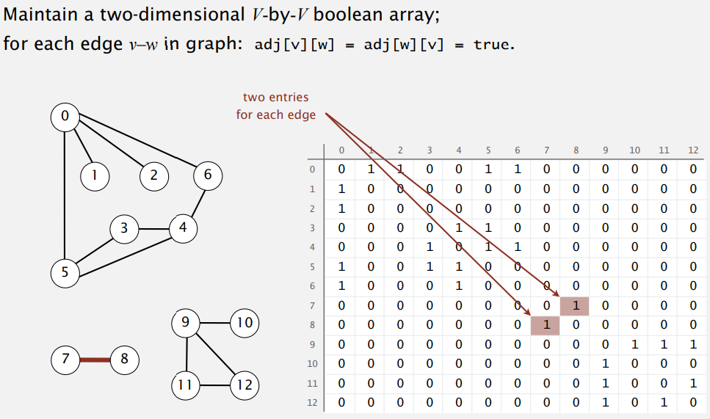
Computer Representation of Graph
Adjacent Table/Matrix: Pros/ Cons?

Slide 6
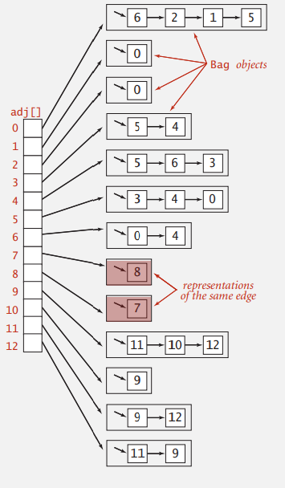
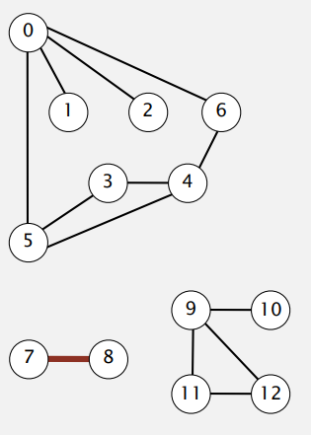
Computer Representation of Graph
Adjacent List: Pros/ Cons?

Slide 7
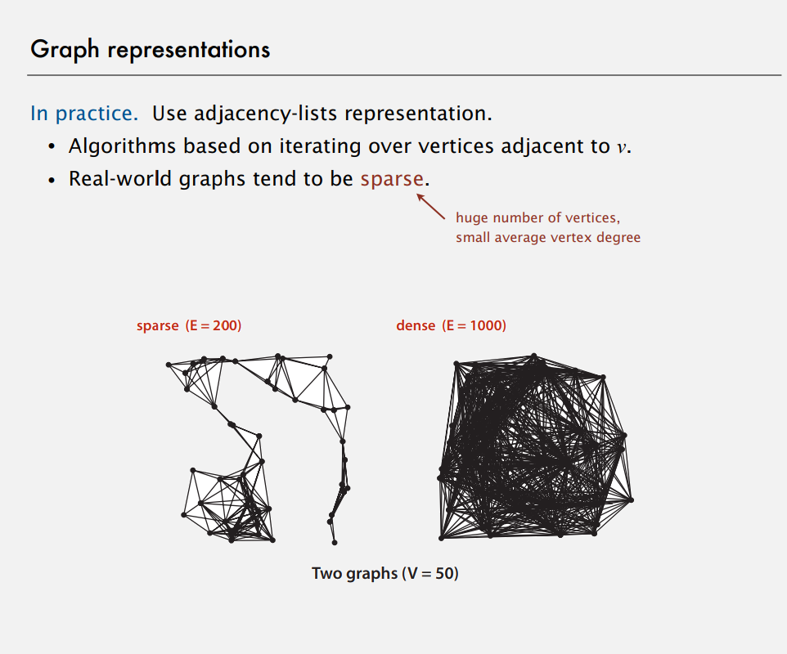

Slide 8
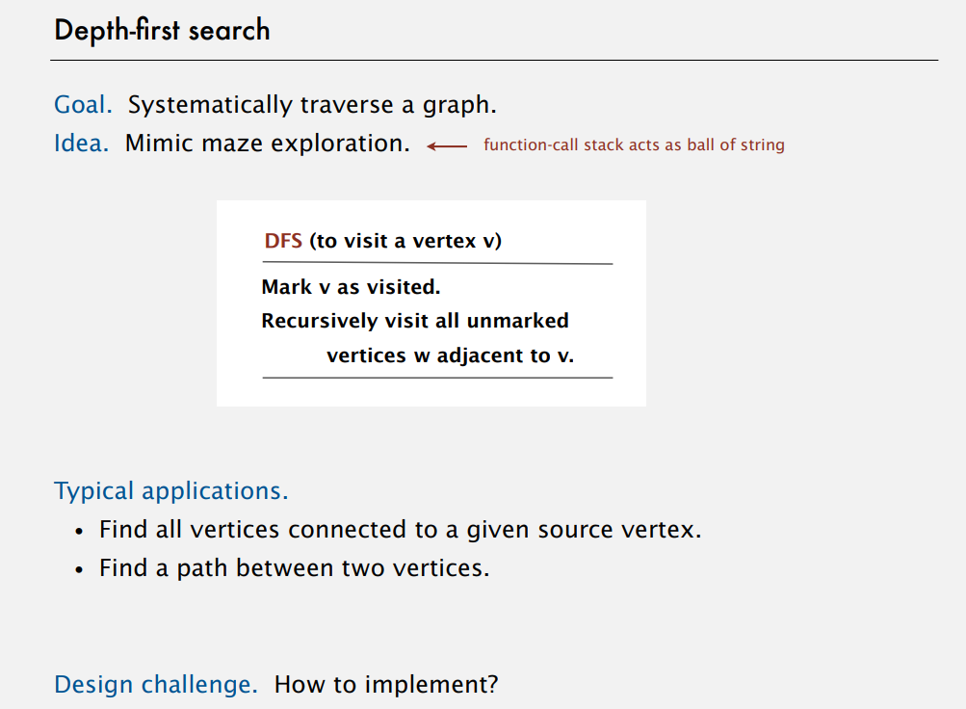
Notes:
graph represetation
adjacent table
linked list
BFS DFS

Slide 9
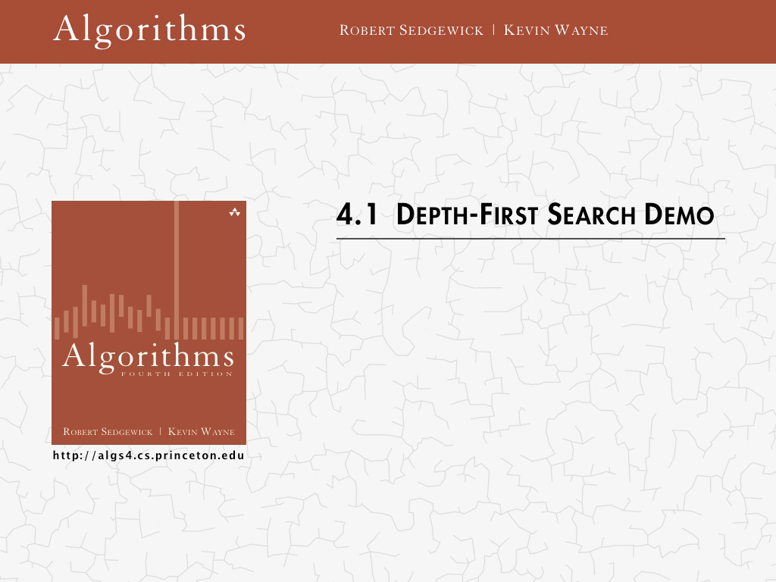
Notes:
graph represetation
adjacent table
linked list
BFS DFS

Slide 10
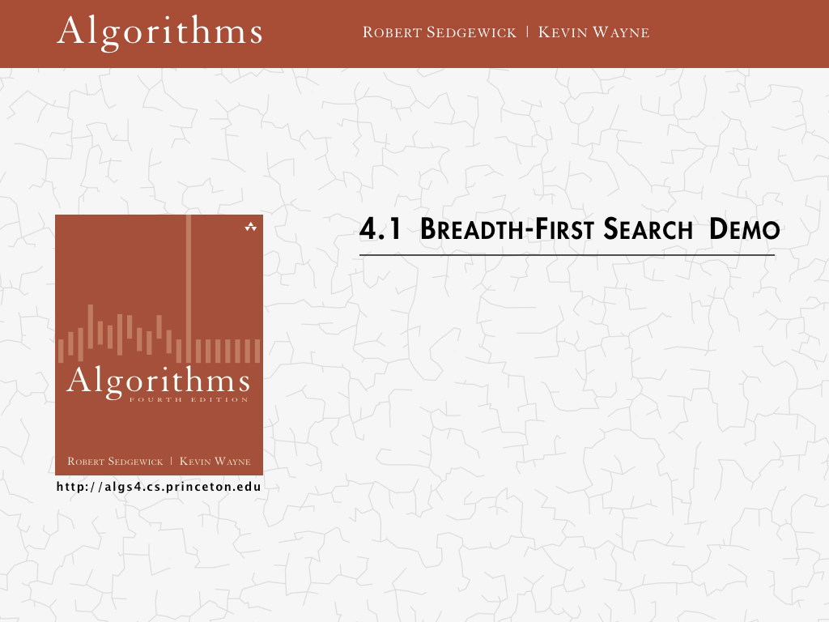
Notes:
linked list
BFS DFS

Slide 11
Algorithmic Techniques
Brute-force algorithms
Take the most direct or obvious solution approach
Enumerate all possible candidate solutions
Divide-and-conquer algorithms
break problem down into sub-problems that similar to the original problem, but smaller in size
Typically leads to recursive algorithms
E.g., MERGESORT
Greedy algorithms
Often applied to optimization problems involving a sequence of choices
At each step, the locally optimal choice is made
Dynamic programming algorithms
Break problem down into sub-problems
Use the solutions to these sub-problems to solve larger sub-problems (reusing results)

Slide 12
Greedy Algorithm: Change Making
Given coins of denominations 1,5,10,25 cents; find out a way to give a customer an amount with the fewest number of coins.
Example: 147 cents
Greedy Algorithm Exercise:
https://leetcode.com/problems/largest-perimeter-triangle/

Slide 13
Dynamic programming: Fibonacci Sequence
The Fibonacci Sequence is the series of numbers:
0, 1, 1, 2, 3, 5, 8, 13, 21, 34, ...
The next number is found by adding up the two numbers before it:
the 2 is found by adding the two numbers before it (1+1),
the 3 is found by adding the two numbers before it (1+2),
the 5 is (2+3),
and so on!
You can try it yourself: https://leetcode.com/problems/fibonacci-number/

Slide 14
BFS & DFS Exercises
Depth First Search exercise:
Find the depth of a binary tree (a tree is also a graph!)
https://leetcode.com/problems/maximum-depth-of-binary-tree/
Breadth First Search exercise:
Find cousins in a binary tree.
Cousins have the same depth (level of the tree), but different parents.
https://leetcode.com/problems/cousins-in-binary-tree/

Slide 15
Exercise / Q&A
Notes:
linked list
BFS DFS

Slide 16
Links to All Exercises
Linked Lists
https://leetcode.com/problems/reverse-linked-list/
Binary Trees
https://leetcode.com/problems/binary-tree-inorder-traversal/
Searching
https://leetcode.com/problems/binary-search/
https://leetcode.com/problems/search-in-a-binary-search-tree/
Sorting
https://leetcode.com/problems/sort-colors/
https://leetcode.com/problems/sort-an-array/
Graph Algorithms (BFS and DFS)
https://leetcode.com/problems/maximum-depth-of-binary-tree/
https://leetcode.com/problems/cousins-in-binary-tree/
Greedy Algorithm
https://leetcode.com/problems/largest-perimeter-triangle/
Dynamic Programming
https://leetcode.com/problems/fibonacci-number/

Slide 17
ADDITIONAL MATERIAL

Slide 18
Tortoise and Rabbits
https://leetcode.com/problems/linked-list-cycle/

Slide 19
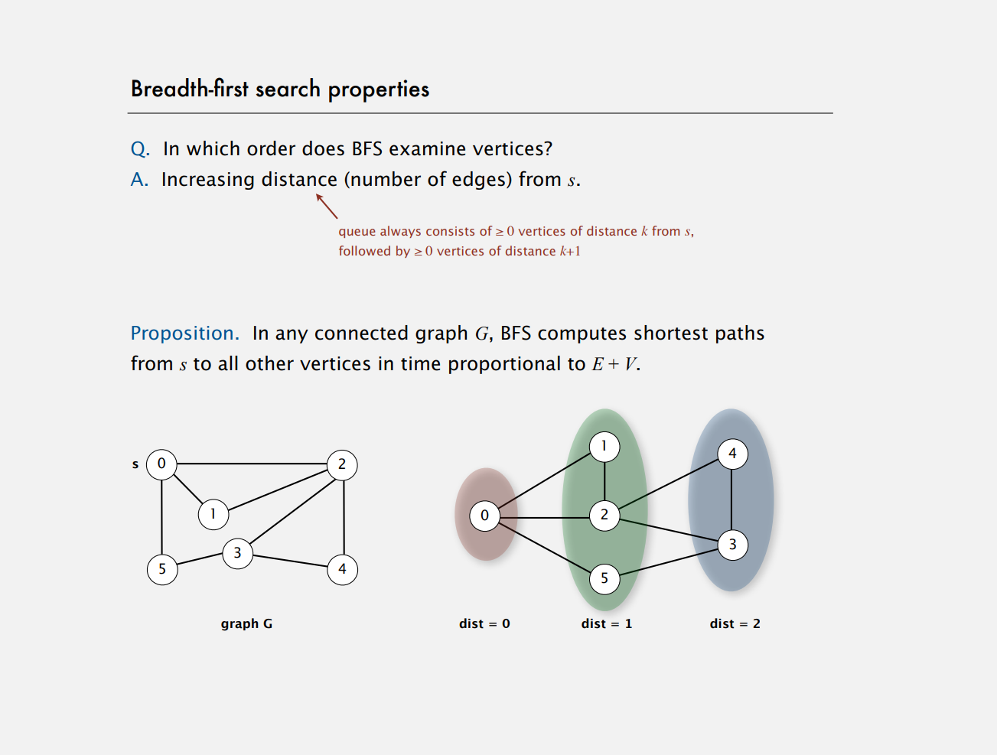
Notes:
linked list
BFS DFS

Slide 20
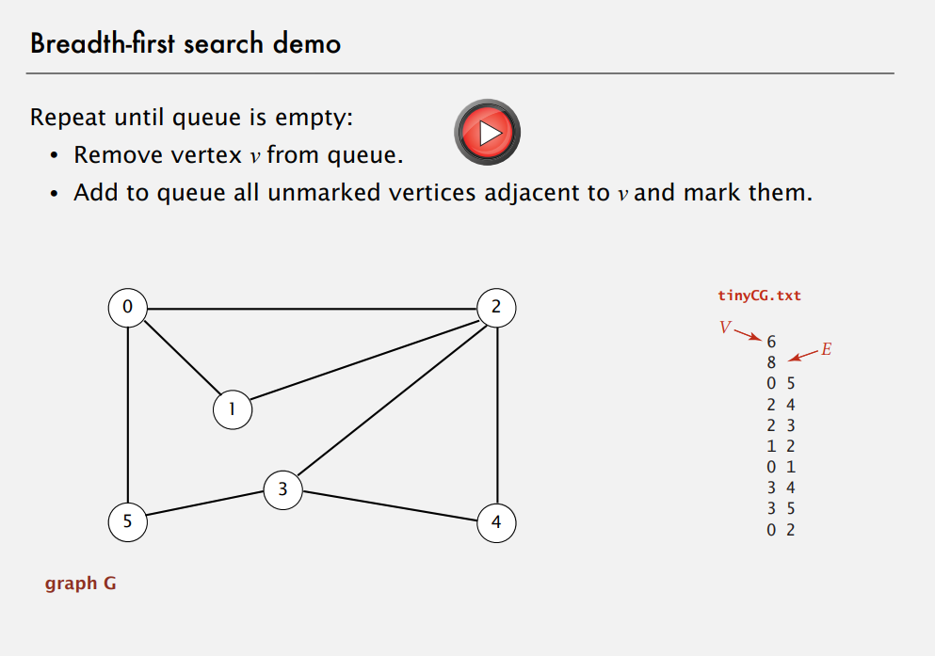

Slide 21
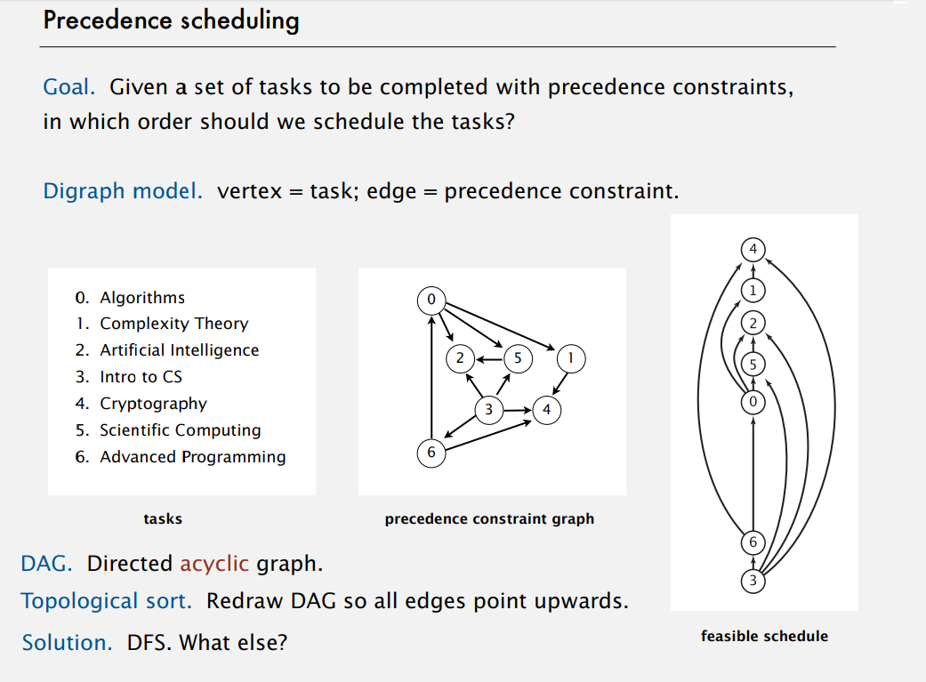

Slide 22
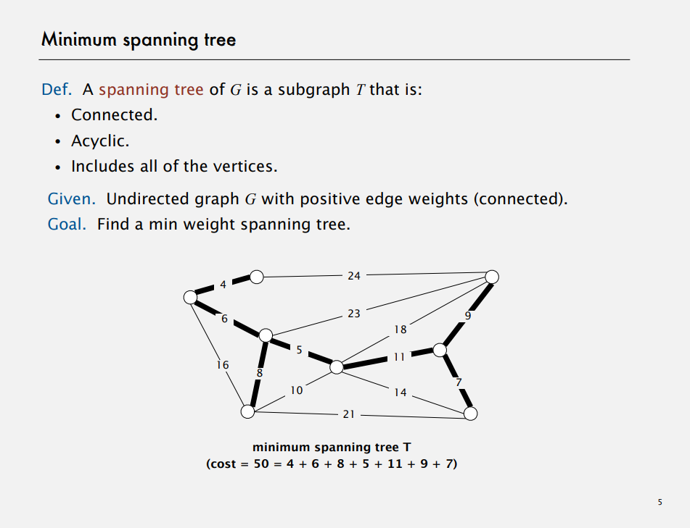

Slide 23
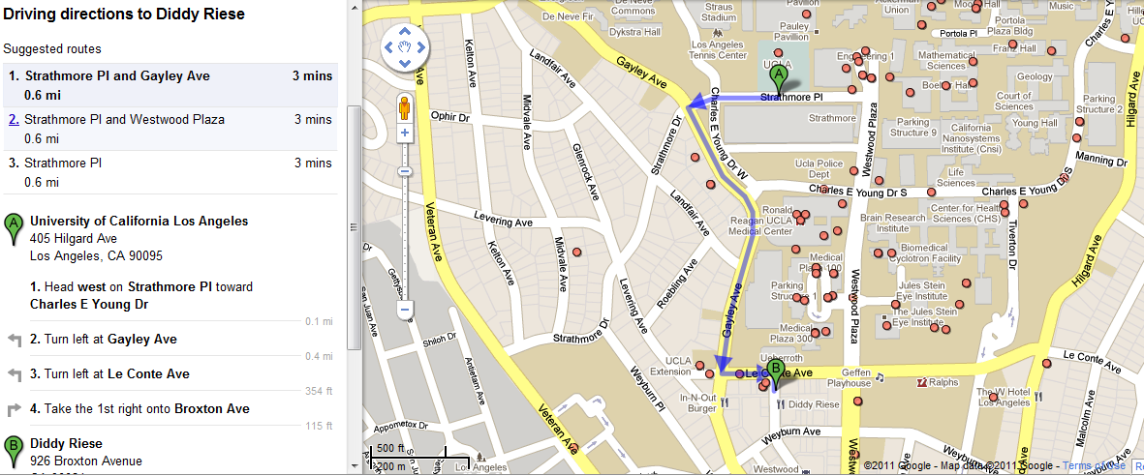


Shortest-Path Problem
Google Maps - determining the fastest route
www.variability.org

Slide 24
Shortest-Path Problem
Google Maps - determining the fastest route
www.variability.org

Slide 25
Class Activity: Shortest Path Algorithm
Can you come up with an algorithm that solves the shortest path problem?
Work in groups
What is the shortest path from s to t?
Example and Animation are from National University of Singapore
2
24
3
9
s
18
14
6
6
2
30
4
19
11
15
5
5
6
20
16
7
t
44

Slide 26
Dijsktra’s Shortest Path Algorithm
Find shortest path from s to t.
2
24
3
9
s
18
14
6
6
2
30
4
19
11
15
5
5
6
20
16
7
t
44
Example and Animation are from National University of Singapore

Slide 27
Dijsktra’s Shortest Path Algorithm
S = { }
PQ = { s, 2, 3, 4, 5, 6, 7, t }
B = { }
∞
∞
0
2
24
3
9
s
∞
18
14
6
6
2
∞
∞
4
30
19
11
15
5
5
6
20
16
7
t
distance label
44
∞
∞
Example and Animation are from National University of Singapore

Slide 28
Dijsktra’s Shortest Path Algorithm
S = { }
PQ = { s, 2, 3, 4, 5, 6, 7, t }
B = { }
dmin
∞
∞
0
2
24
3
9
s
∞
18
14
6
6
2
∞
∞
30
4
19
11
15
5
5
6
20
16
7
t
distance label
∞
44
∞
Example and Animation are from National University of Singapore

Slide 29
Dijsktra’s Shortest Path Algorithm
S = { s }
PQ = { 2, 3, 4, 5, 6, 7, t }
B = { s }
decrease key
∞
∞
9
0
X
2
24
3
9
s
14
∞
18
14
X
6
6
2
∞
∞
30
4
19
11
15
5
5
6
20
16
7
15
t
44
∞
distance label
∞
X
Example and Animation are from National University of Singapore

Slide 30
Dijsktra’s Shortest Path Algorithm
S = { s }
PQ = { 2, 3, 4, 5, 6, 7, t }
B = { s }
dmin
∞
∞
9
0
X
2
24
3
9
s
14
∞
18
14
X
6
6
2
∞
∞
4
30
19
11
15
5
5
6
20
16
7
15
t
44
distance label
∞
∞
X
Example and Animation are from National University of Singapore

Slide 31
Dijsktra’s Shortest Path Algorithm
S = { s, 2 }
PQ = { 3, 4, 5, 6, 7, t }
B = { s, 2 }
∞
∞
9
X
2
24
3
0
9
s
∞
14
18
14
X
6
6
2
∞
30
∞
4
19
11
15
5
5
6
20
16
7
t
44
∞
15
∞
X
Example and Animation are from National University of Singapore

Slide 32
Dijsktra’s Shortest Path Algorithm
S = { s, 2 }
PQ = { 3, 4, 5, 6, 7, t }
B = { s, 2 }
decrease key
∞
33
∞
X
9
X
2
24
3
0
9
s
∞
14
18
14
X
6
6
2
∞
30
∞
4
19
11
15
5
5
6
20
16
7
t
44
∞
15
∞
X
Example and Animation are from National University of Singapore

Slide 33
Dijsktra’s Shortest Path Algorithm
S = { s, 2 }
PQ = { 3, 4, 5, 6, 7, t }
B = { s, 2 }
∞
33
∞
X
9
X
2
24
3
0
9
dmin
s
∞
14
18
14
X
6
6
2
∞
30
∞
4
19
11
15
5
5
6
20
16
7
t
44
∞
15
∞
X
Example and Animation are from National University of Singapore

Slide 34
Dijsktra’s Shortest Path Algorithm
S = { s, 2, 6 }
PQ = { 3, 4, 5, 7, t }
B = { s, 6 }
32
∞
33
∞
X
X
9
X
2
24
3
0
9
s
∞
14
18
14
X
6
6
2
44
∞
∞
4
30
X
19
11
15
5
5
6
20
16
7
t
44
∞
15
∞
X
Example and Animation are from National University of Singapore

Slide 35
Dijsktra’s Shortest Path Algorithm
S = { s, 2, 6 }
PQ = { 3, 4, 5, 7, t }
B = { s, 6 }
32
∞
33
∞
X
X
9
X
2
24
3
0
9
s
∞
14
18
14
X
6
6
2
44
∞
∞
4
30
X
19
11
15
5
5
6
20
16
7
t
44
∞
15
dmin
∞
X
Example and Animation are from National University of Singapore

Slide 36
Dijsktra’s Shortest Path Algorithm
S = { s, 2, 6, 7 }
PQ = { 3, 4, 5, t }
B = { s, 7 }
32
∞
33
∞
X
X
9
X
2
24
3
0
9
s
∞
14
18
14
X
6
6
2
44
35
∞
X
∞
4
30
X
19
11
15
5
5
6
20
16
7
t
44
59
∞
∞
15
X
X
Example and Animation are from National University of Singapore

Slide 37
Dijsktra’s Shortest Path Algorithm
S = { s, 2, 6, 7 }
PQ = { 3, 4, 5, t }
B = { s, 7 }
dmin
32
∞
33
∞
X
X
9
X
2
24
3
0
9
s
∞
14
18
14
X
6
6
2
44
35
∞
X
∞
4
30
X
19
11
15
5
5
6
20
16
7
t
44
59
∞
∞
15
X
X
Example and Animation are from National University of Singapore

Slide 38
Dijsktra’s Shortest Path Algorithm
S = { s, 2, 3, 6, 7 }
PQ = { 4, 5, t }
B = { s, 6, 3 }
32
∞
33
∞
X
X
9
X
2
24
3
0
9
s
∞
14
18
14
X
6
6
2
44
35
34
∞
X
X
∞
4
30
X
19
11
15
5
5
6
20
16
7
t
44
51
59
∞
∞
15
X
X
X
Example and Animation are from National University of Singapore

Slide 39
Dijsktra’s Shortest Path Algorithm
S = { s, 2, 3, 6, 7 }
PQ = { 4, 5, t }
B = { s, 6, 3 }
32
∞
33
∞
X
X
9
X
2
24
3
0
9
s
∞
14
18
14
X
6
6
2
44
35
34
∞
X
X
∞
4
30
X
19
11
15
5
5
6
20
dmin
16
7
t
44
51
59
∞
∞
15
X
X
X
Example and Animation are from National University of Singapore

Slide 40
Dijsktra’s Shortest Path Algorithm
S = { s, 2, 3, 5, 6, 7 }
PQ = { 4, t }
B = { s, 6, 3, 5 }
32
∞
33
∞
X
X
9
X
2
24
3
0
9
s
∞
14
18
14
X
6
6
2
35
34
45
∞
44
X
X
X
∞
4
30
X
19
11
15
5
5
6
20
16
7
t
44
50
51
59
∞
∞
15
X
X
X
X
Example and Animation are from National University of Singapore

Slide 41
Dijsktra’s Shortest Path Algorithm
S = { s, 2, 3, 5, 6, 7 }
PQ = { 4, t }
B = { s, 6, 3, 5 }
32
∞
33
∞
X
X
9
X
2
24
3
0
9
s
∞
14
18
14
X
6
6
2
35
34
45
∞
44
X
X
X
∞
4
30
X
19
11
15
5
dmin
5
6
20
16
7
t
44
50
51
59
∞
∞
15
X
X
X
X
Example and Animation are from National University of Singapore

Slide 42
Dijsktra’s Shortest Path Algorithm
S = { s, 2, 3, 4, 5, 6, 7 }
PQ = { t }
B = { s, 6, 3, 5, 4 }
32
∞
33
∞
X
X
9
X
2
24
3
0
9
s
∞
14
18
14
X
6
6
2
35
34
45
∞
44
X
X
X
∞
4
30
X
19
11
15
5
5
6
20
16
7
t
44
50
51
59
∞
∞
15
X
X
X
X
Example and Animation are from National University of Singapore

Slide 43
Dijsktra’s Shortest Path Algorithm
S = { s, 2, 3, 4, 5, 6, 7 }
PQ = { t }
B = { s, 6, 3, 5, 4 }
32
∞
33
∞
X
X
9
X
2
24
3
0
9
s
∞
14
18
14
X
6
6
2
35
34
45
∞
44
X
X
X
∞
4
30
X
19
11
15
5
5
6
20
16
7
t
44
dmin
50
51
59
∞
∞
15
X
X
X
X

Slide 44
Dijsktra’s Shortest Path Algorithm
S = { s, 2, 3, 4, 5, 6, 7, t }
PQ = { }
B = { s, 6, 3, 5, t }
32
∞
33
∞
X
X
9
X
2
24
3
0
9
s
∞
14
18
14
X
6
6
2
35
34
45
∞
44
X
X
X
∞
4
30
X
19
11
15
5
5
6
20
16
7
t
44
50
51
59
∞
∞
15
X
X
X
X

Slide 45
Dijsktra’s Shortest Path Algorithm
S = { s, 2, 3, 4, 5, 6, 7, t }
PQ = { }
B = { s, 6, 3, 5, t }
32
∞
33
∞
X
X
9
X
2
24
3
0
9
s
∞
14
18
14
X
6
6
2
35
34
45
∞
44
X
X
X
∞
4
30
X
19
11
15
5
5
6
20
16
7
t
44
50
51
59
∞
∞
15
X
X
X
X
Example and Animation are from National University of Singapore

Slide 46
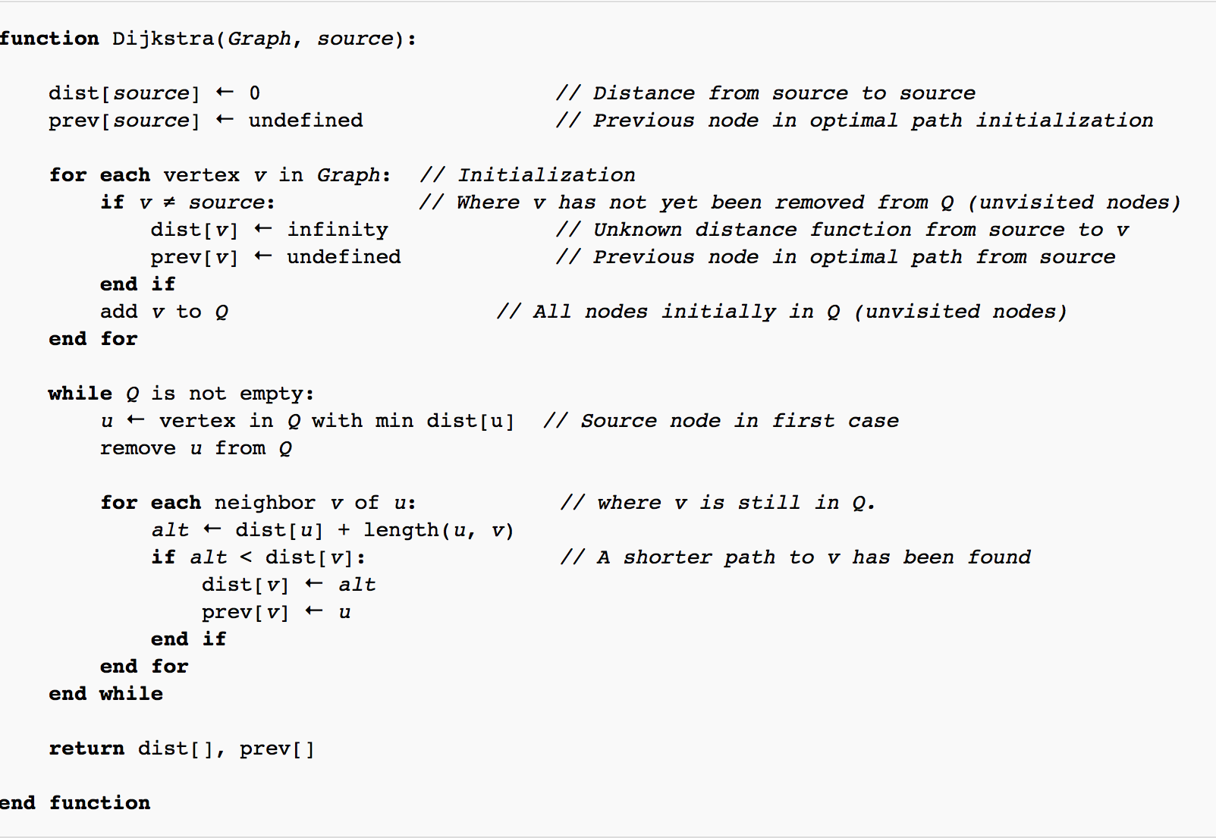
Dijsktra’s Shortest Path Algorithm
Source: https://en.wikipedia.org/wiki/Dijkstra%27s_algorithm

Slide 47
Importance of Efficiency
Computers have finite speed, finite memory.
Need to minimize amount of computation that the machines needs to make.
Algorithm X executes in 10n² + n / 3.7 + 22 steps
Algorithm Y executes in 100n log n + 14n + 22 steps
Which algorithm is better?
www.variability.org

Slide 48
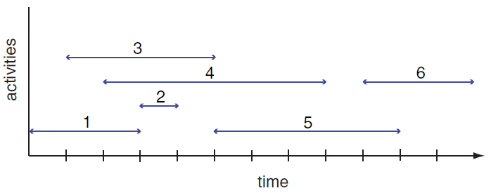
Greedy Algorithm
Activity Selection Problem
Given: A set of proposed activities that wish to use a resource, which can only be used by one activity at a time
Problem: Find maximum-size set of activities that do not have a time conflict

Slide 49
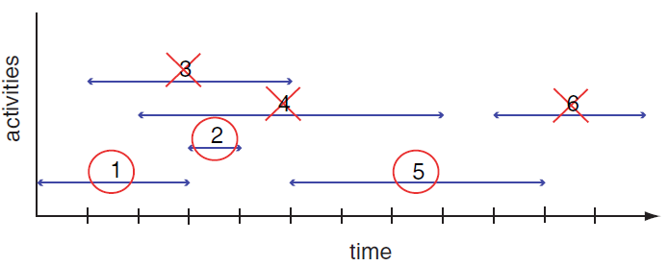
Greedy Algorithm
Greedy choice: Pick the remaining compatible activity that has the earliest finish time
Can you write an algorithm that does this?
Notes:
Tasks ordered by finish time

Slide 50
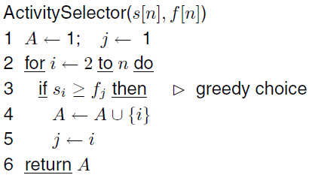
Algorithm for Activity Selection Problem
What is the running time for this algorithm?

Slide 51
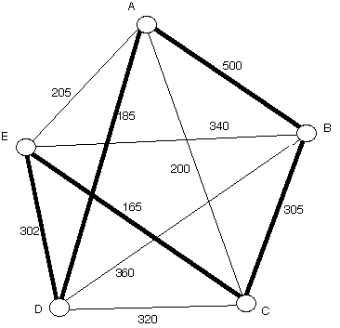
Nearest Neighbor Algorithm
Start at a vertex
Find the lightest edge connecting the current vertex and an unvisited vertex V
Set current vertex to V
Mark V as visited
Terminate when all the vertices have been visited
Repeat from step 2
Example: Starts from Vertex A and returns
to starting point at the end
Path: A - D - E - C - B - A

Slide 52
Deficiencies of Nearest Neighbor
Worst case: algorithm can result in a path much longer than the optimal path
Won’t work in case of incomplete graph
When some cities are not connected
Any ideas for a better algorithm?
Notes:
https://web.tuke.sk/fei-cit/butka/hop/htsp.pdf

